Slide 1
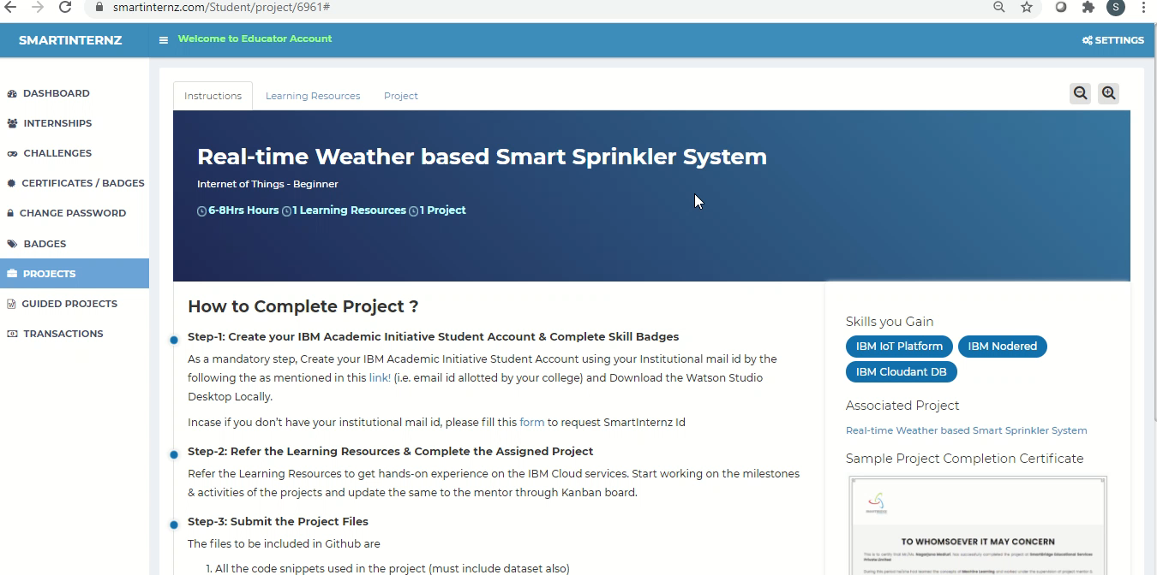
Real-time Weather based Smart Sprinkler System

